Slide 1

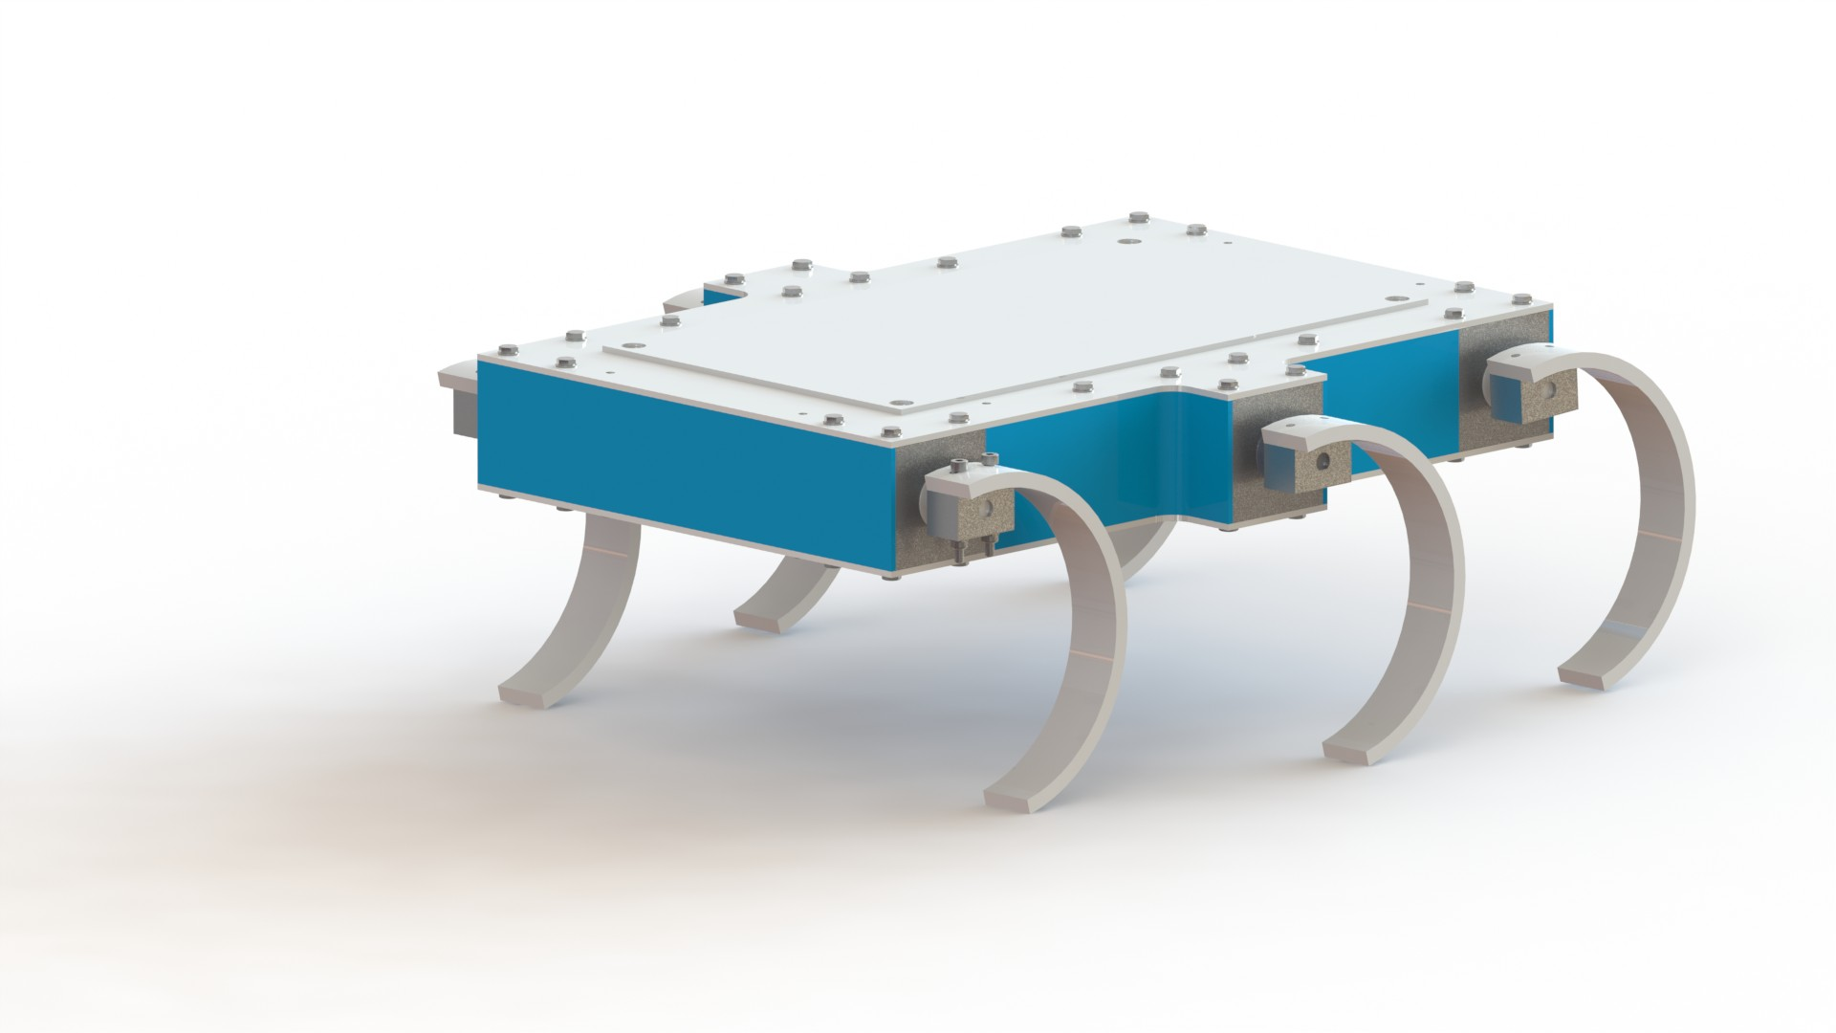
RUDRA-RHex
Smartphone controlled Rough Terrain Robot
By,
Harikrishnan J
Aditi Prasad
Dega Chandrika
S3 ECE Amritapuri Campus

Slide 2
Overview
RUDRA platform include six legs, each with a single rotary actuator at the hip.
Legs are designed from compliant materials to produce energetic running gaits.
The leg modules are controlled from a central computer, which takes user commands or sensor feedback to decide how the legs should move.

Slide 3

With new levels of mobility and durability, and the capability for rapid behavior development with a modular payload system, RUDRA is an effective research machine both in the laboratory and in outdoor field tests.
Six powerful motors actuate compliant legs, allowing RUDRA to traverse a wide variety of terrains, including asphalt, grass, sand, mud, and rocks.
By using a mil-spec rail mounted interface and standard electrical connections, RUDRA can support a wide variety of payloads, making it a mobile “laboratory on legs”.
Now adding an extra sensor or testing a new behavioral algorithm is as easy as on a bench in the lab.

Slide 4
SOFTWARE &
DEVELOPMENT BOARD
01
SENSORS
02
CONTROL
03

Slide 5
ROBOTIC HAND
04
CAMERA
05
DESIGN
06

Slide 6
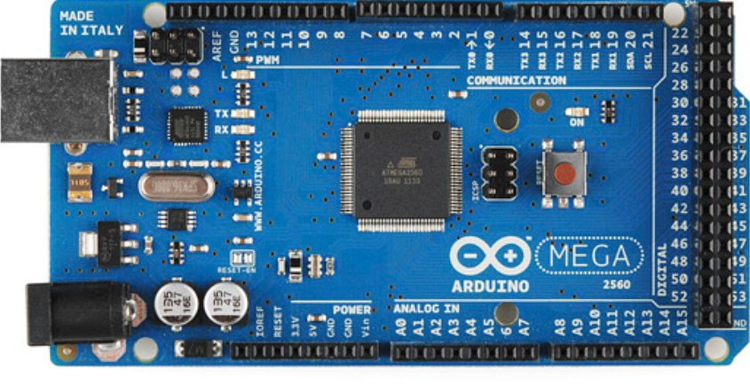
Development Board & Software
The Mega 2560 is a microcontroller board based on the ATmega2560.
It has 54 digital input/output pins (of which 15 can be used as PWM outputs), 16 analog inputs, 4 UARTs (hardware serial ports), a 16 MHz crystal oscillator, a USB connection, a power jack, an ICSP header, and a reset button.
SOFTWARE:- ARDUINO IDE

Slide 7
Technical specs
Microcontroller | ATmega2560
Operating Voltage | 5V
Input Voltage (recommended) | 7-12V
Input Voltage (limit) | 6-20V
Digital I/O Pins | 54 (of which 15 provide PWM output)
Analog Input Pins | 16
DC Current per I/O Pin | 20 mA
DC Current for 3.3V Pin | 50 mA
Flash Memory | 256 KB of which 8 KB used by bootloader
SRAM | 8 KB
EEPROM | 4 KB
Clock Speed | 16 MHz
LED_BUILTIN | 13
Length | 101.52 mm
Width | 53.3 mm
Weight | 37 g

Slide 8
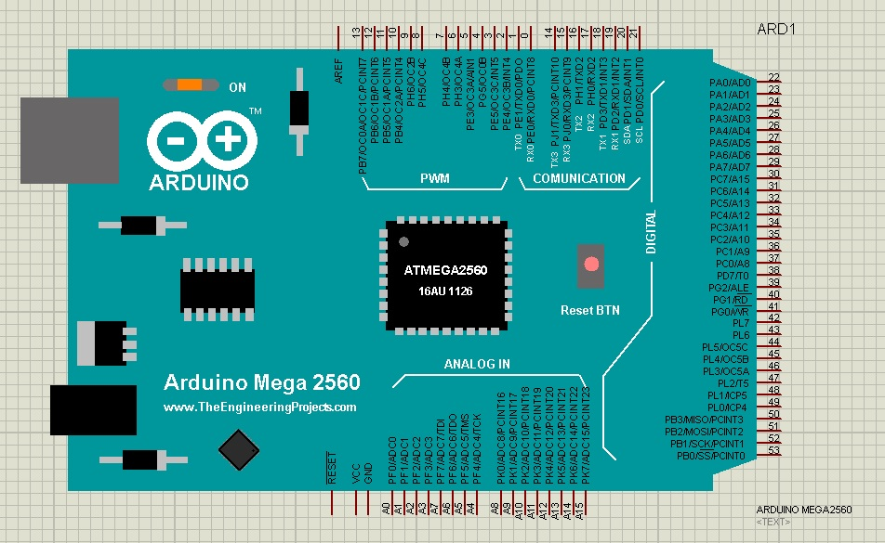
PIN LAYOUT

Slide 9
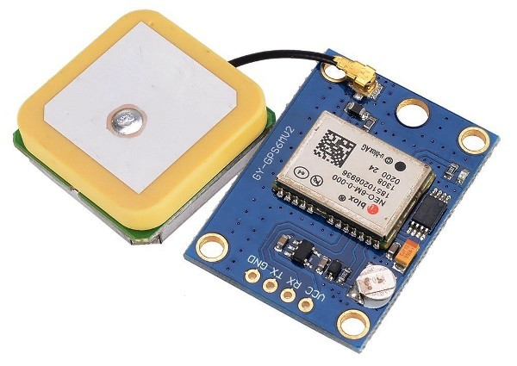
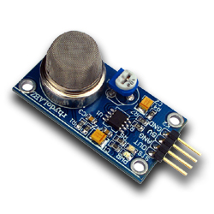
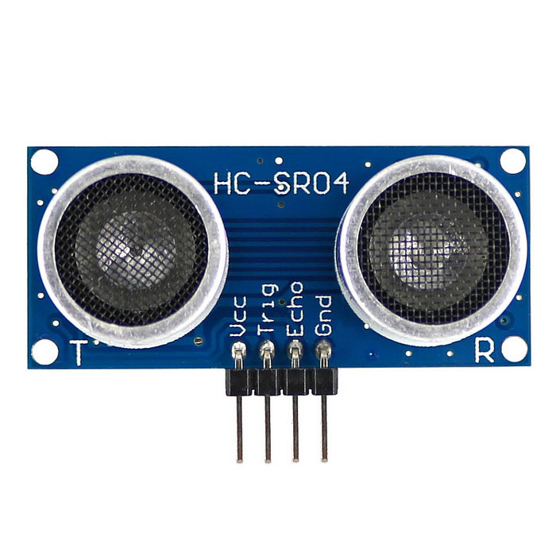
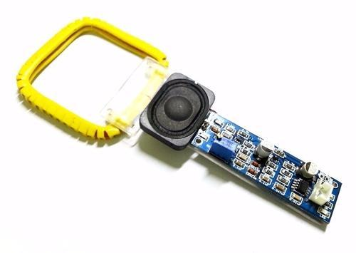
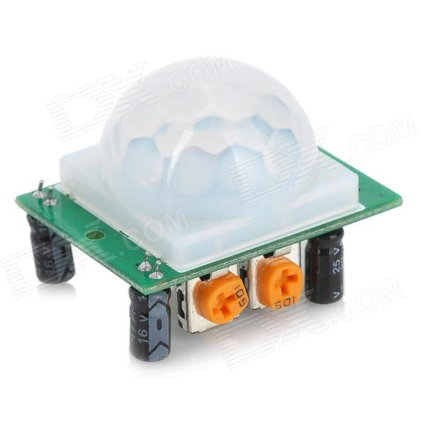
SENSORS
GPS
SENSOR
01
GAS SENSOR
03
METAL DETECTOR
ULTRASONIC
SENSOR
02
05
PIR HUMAN SENSOR
04

Slide 10
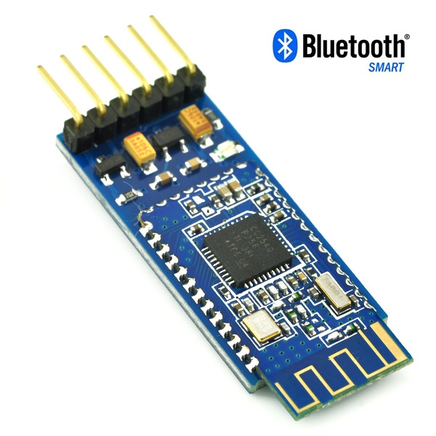
CONTROL
The platform is controlled by a smartphone connected over a bluetooth module.
By making use of an app called”Bluetooth Electronics” to configure and give instructions to the robot of its motion.
The robot also sends real time feedback of sensors back to the smartphone.

Slide 11
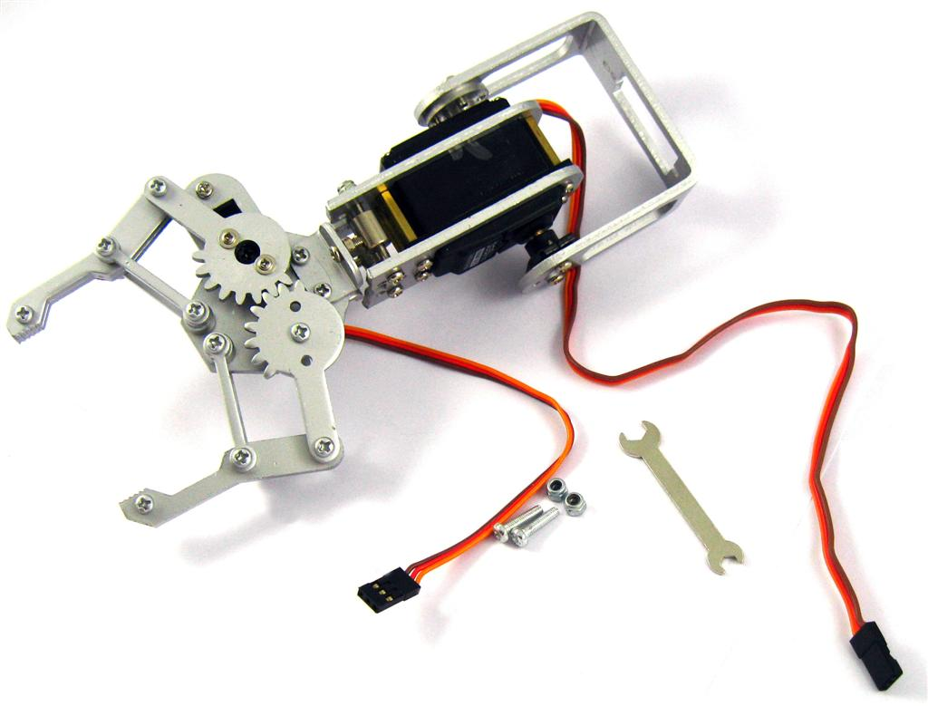
3-DOF Wireless control Robotic Arm
The system uses a 3-DOF arm for pick and place operation.
Bluetooth controlled.
Accurate position obtained using Servo.
Works as a standalone module.

Slide 12
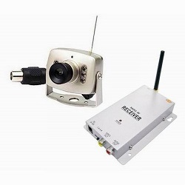
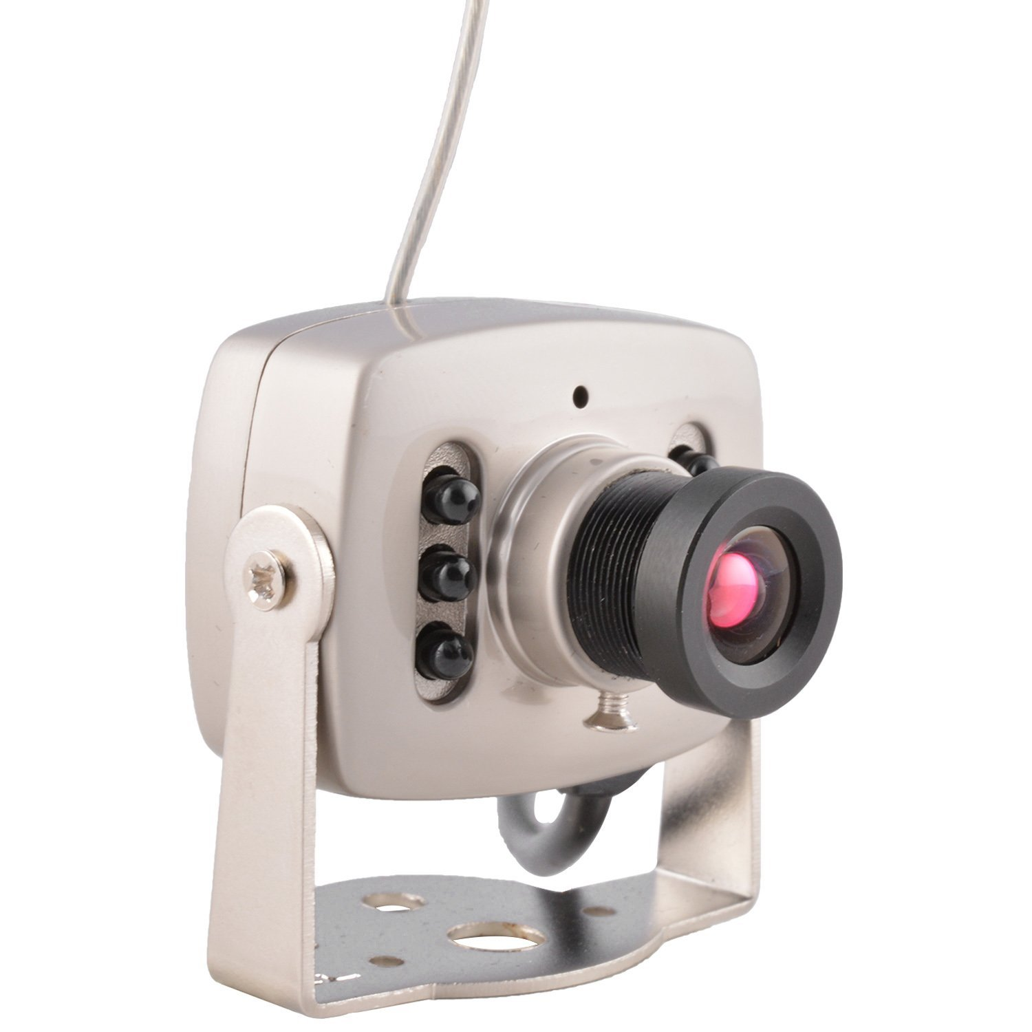
CAMERA
It uses a HD night vision camera.
Rotated by a servo to increase area of coverage.
Wireless transmission of Video and Audio.
Data shown in a laptop(record if wanted) Live streaming.

Slide 13
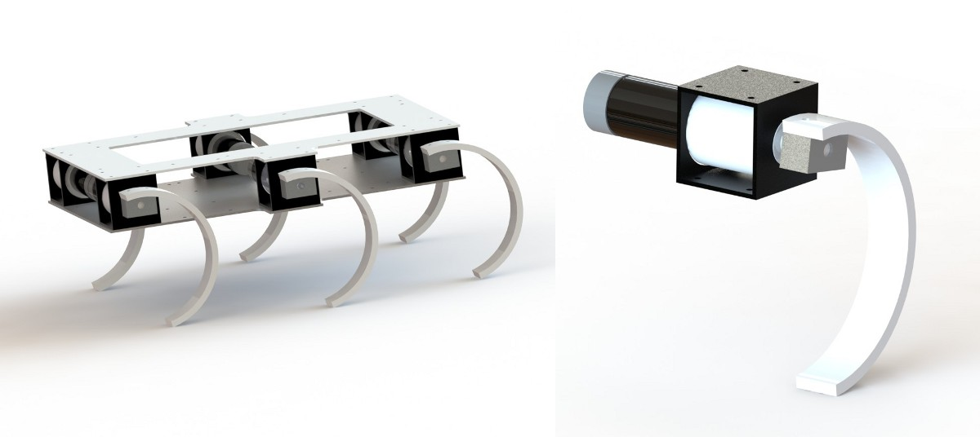
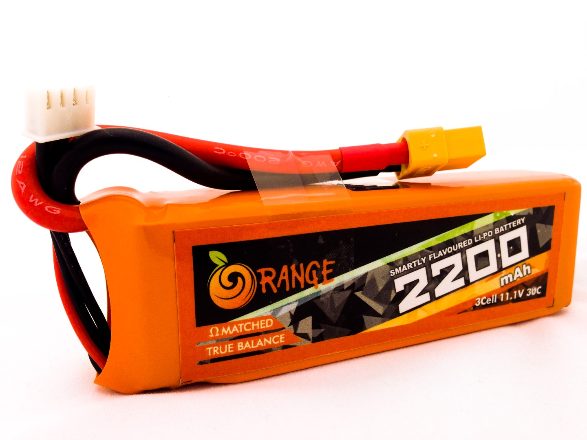
DESIGN ASPECTS
The robot has 6 individual high torque motors with their respective drivers.
The sytem is powered by a 2200 Li-Po battery.
The ultrasonic sensor along with the camera system and the robotic arm are placed in the front of the robotto get a wide coverage of the space.
The gas sensor along with the metal detector is placed at the back of the body as both can detect from around the space.
A soft cussion cover the bottom part of the robot.
The PIR sensor and GPS module are placed at the top of the robot for better readings.

Slide 14
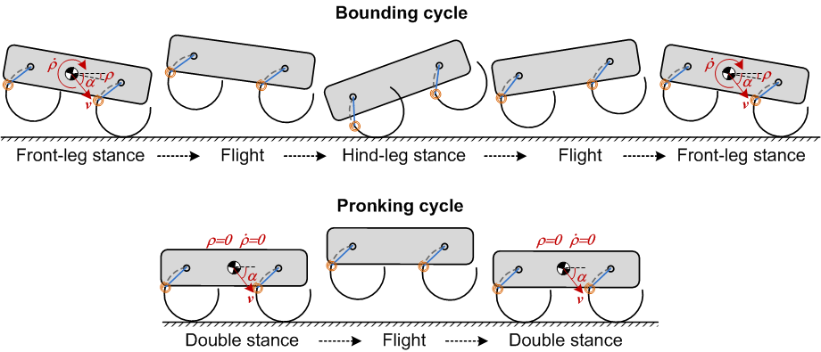
APPLICATIONS
The overarching goal of the RUDRA project was to develop a robotic mobility system that could navigate over highly broken and unstable, natural terrain with a competence arising from insights about animal locomotion.

Slide 15
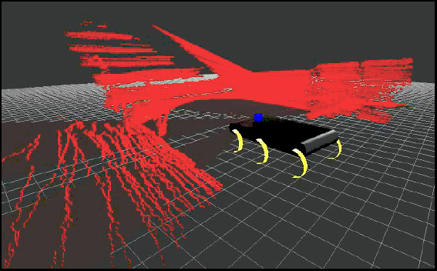
APPLICATION IN REAL LIFE
Robot assisted search and rescue. Inspection and structural assessment of critical infrastructure.
Nuclear site monitoring, decommissioning, and hazardous waste cleanup. Search and rescue.
Floods, landslides, and earthquakes.
It can access any terrain and carry payload.

Slide 16
Special Thanks
Dr. Rajesh Kannan Megalingam
Srikanth M Mohan
Our mentors and wellwishers.

Slide 17
THANK YOU :)

